Slide 1
AUTOMATION
Automatically controlled operation of an apparatus, process, or system by mechanical or electronic devices.
Types of automation
Numerically controlled(NC) equipment
Computer numerical control(CNC)
Direct numerical control(DNC)
Computer-Aided manufacturing(CAM)
Computer integrated manufacturing(CIM)

Slide 2
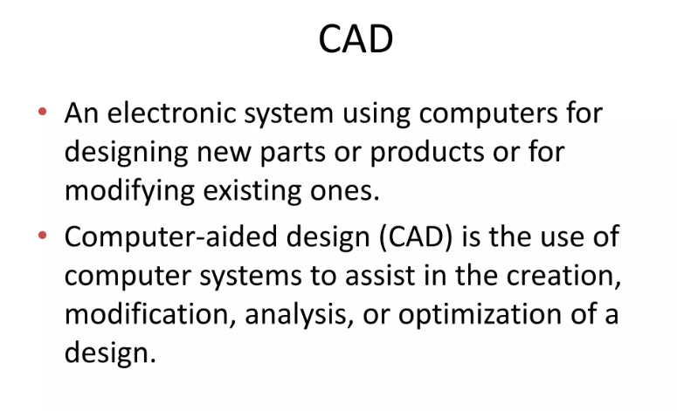
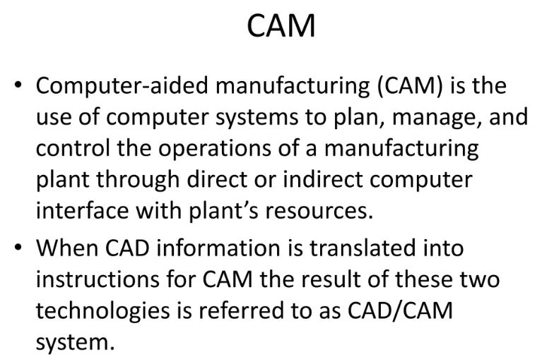

Slide 3
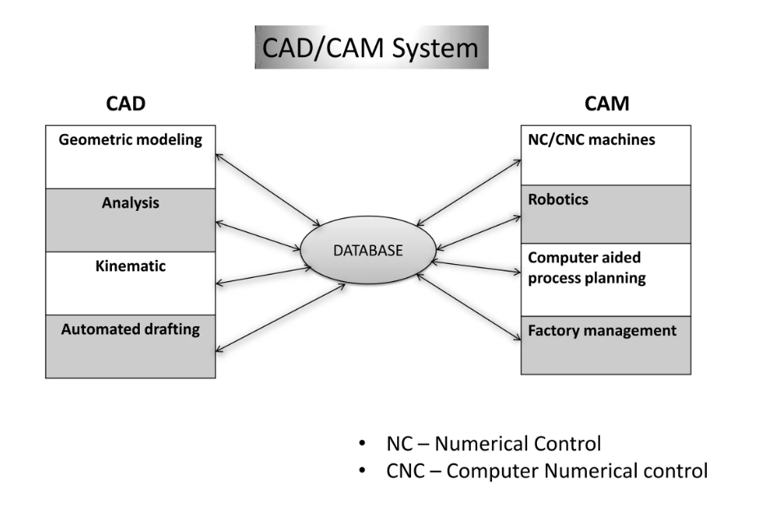

Slide 4
NUMERICAL CONTROL
Control of a machine tool by means of recorded information
on punched tape or cards.
It is a method of automation in which various functions of
machine tools are controlled by letters, numbers and symbols.
System automatically interprets these data and converts them to output signals, which, in turn control various machine components

Slide 5
3 BASIC COMPONENTS
Program of instructions
Machine Control Unit (MCU)
The MCU translates it into electrical signals. These signals operate a servo system which controls the motion of tool, work piece and the related auxiliaries
Processing equipment

Slide 6
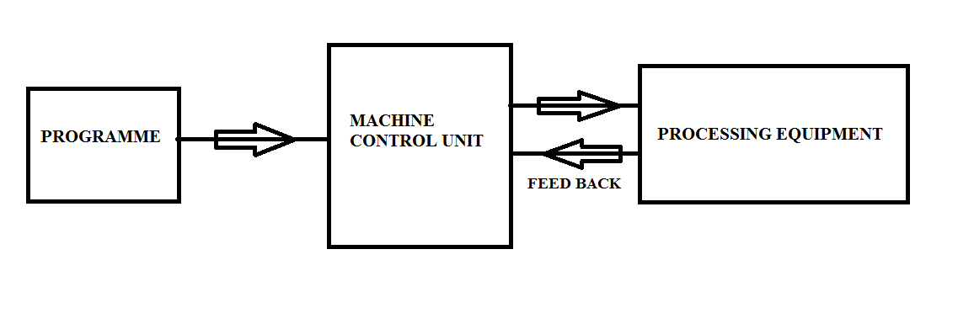

Slide 7
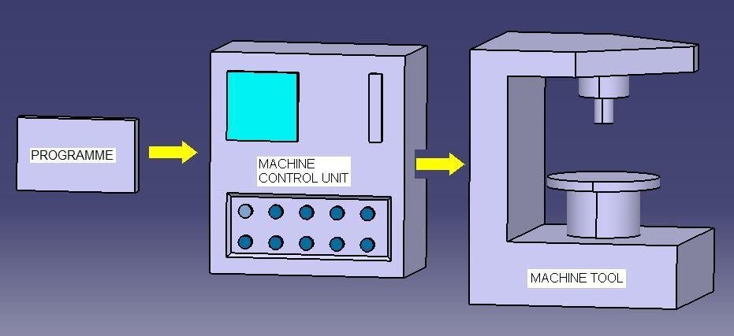

Slide 8
PROGRAM OF INSTRUCTIONS
Detailed step by step commands that directs the actions of the processing equipment. Co-ordinate information(x, y and z movements required for work and tool) regarding the component is recorded on a tape and is fed to the control unit
MCU
It consists of tape reader, signal output channels, sequence control and related control hardware that stores the program of instruction. Control unit convert the commands into electric signals and these signals are sent to processing equipment(machine tool)
PROCESSING EQUIPMENT
Performs useful work with the help of a servo system

Slide 9
ADVANTAGES
Greater accuracy
Lower scrap rates
More – complex part geometries are possible
Less floor space is required
Operator skill level requirements are less
Higher production rate
DISADVANTAGES
Higher investment cost
Higher maintenance effort

Slide 10
CNC MACHINES
A computer is used to prepare and control the operations of
the machine tool
CNC refers to a computer that is joined to the NC machine
The program is entered into the computer through a keyboard or disc or tape and stored in its memory
Whenever the part is to be machined, the program is called from its memory
Also, if it is required to have a change in any dimension, the program can be called and edited to incorporate the changes(not possible in a NC machine). This eliminates the repeated use of tape

Slide 11
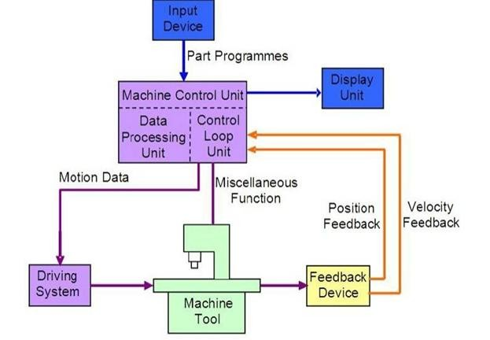

Slide 12
ADVANTAGES
High accuracy in machining
Storage of more than one program
Program can be edited
Short production time
Greater manufacturing flexibility
Better quality control
Repeatability of accuracy is possible
DISADVANTAGES
High cost
Requirement of skilled programmer

Slide 13
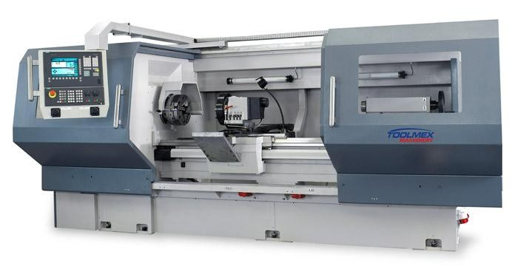
CNC LATHE MACHINE

Slide 14
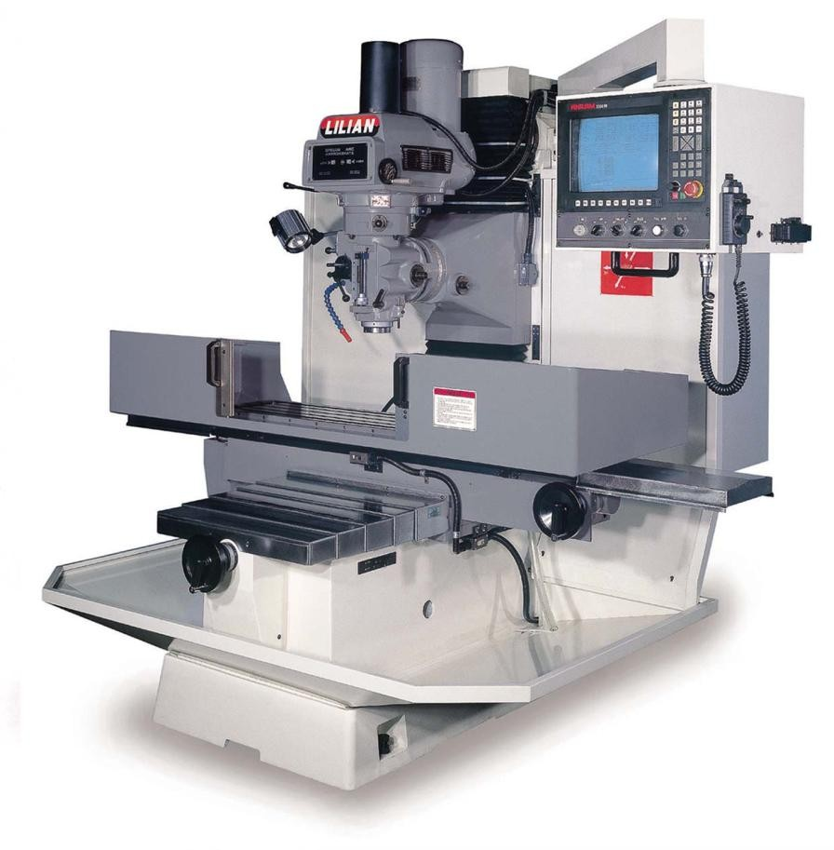
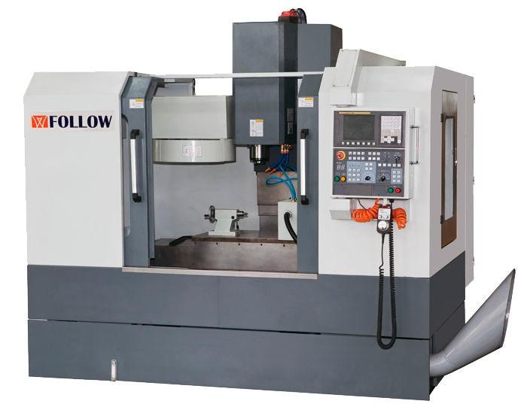
CNC MILLING MACHINE

Slide 15
DNC
In Direct Numerical Control(DNC) system, a number of machine tools are controlled by a single computer
The program was transmitted to the MCU directly from the computer, one block of instructions at a time
Central computer also received data back from the machines

Slide 16
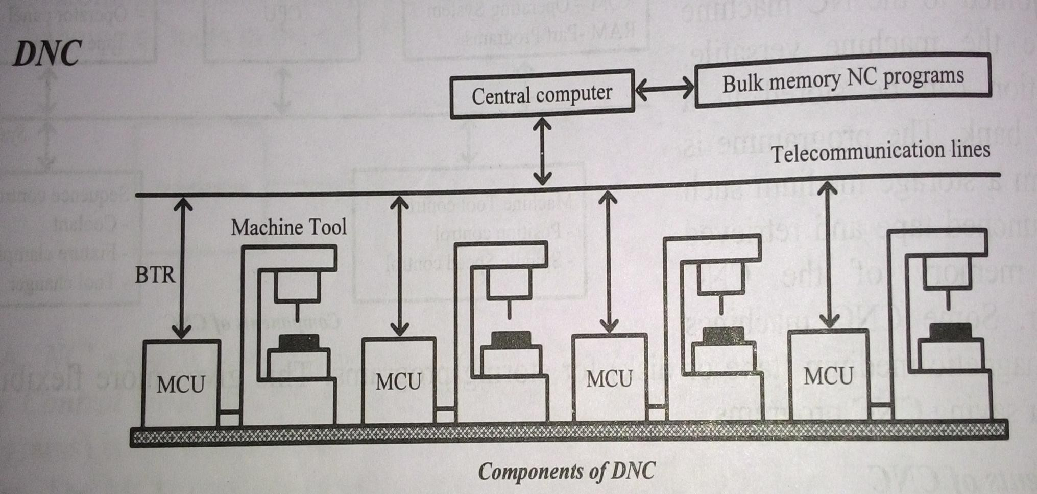

Slide 17
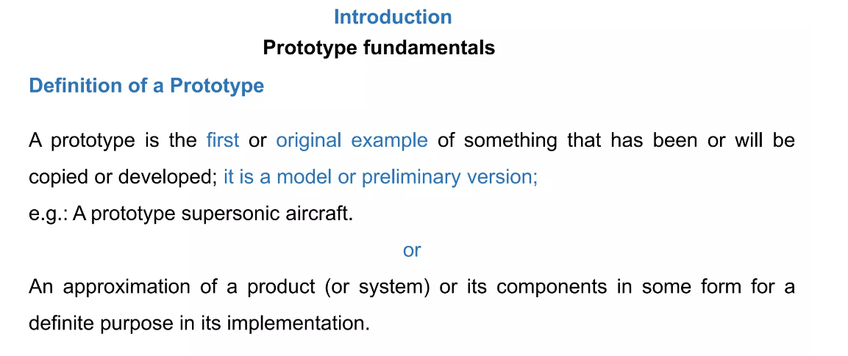

Slide 18
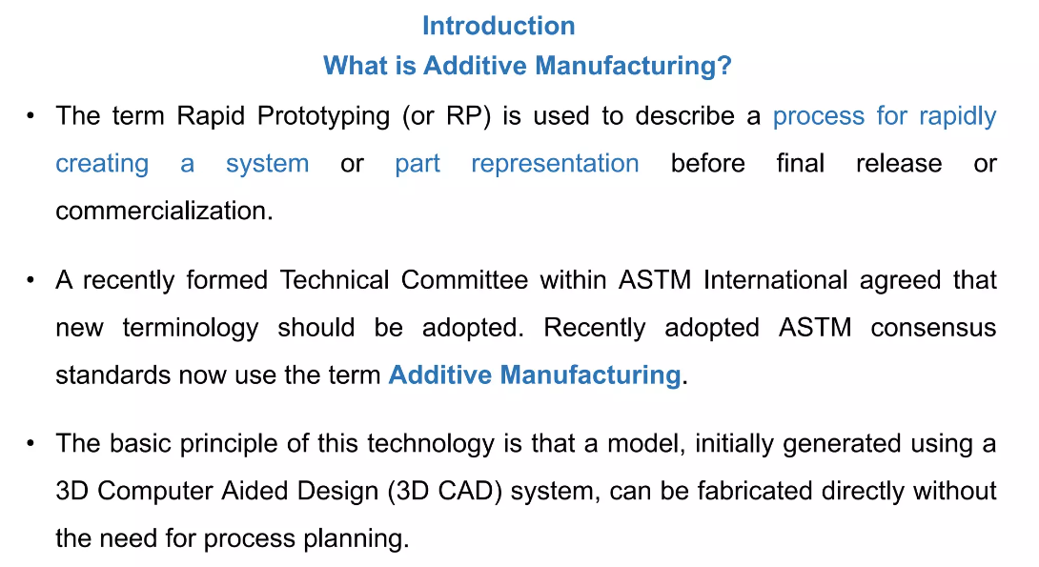

Slide 19
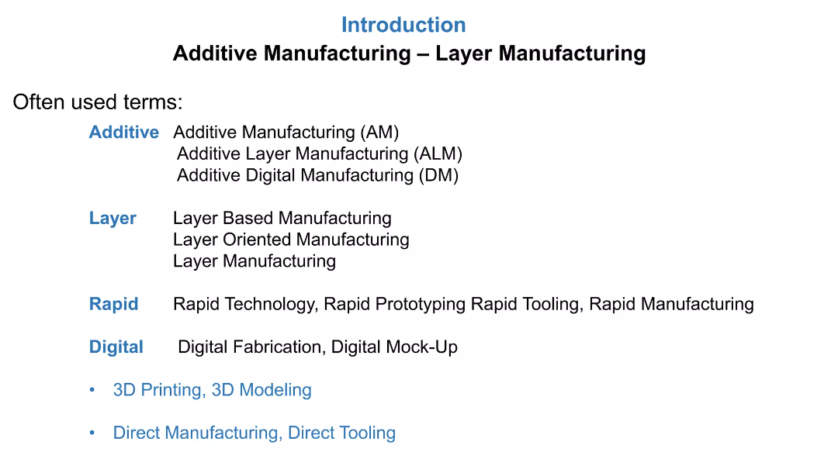

Slide 20
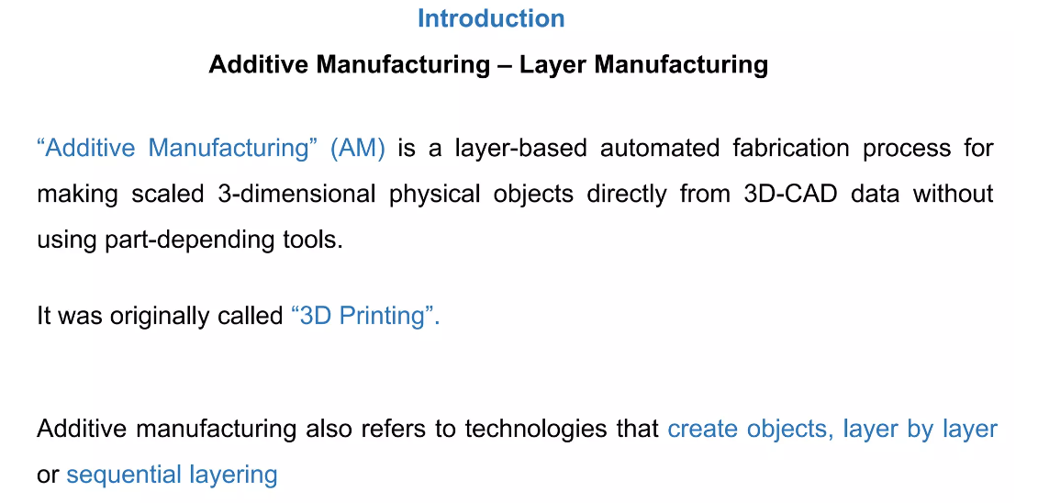

Slide 21
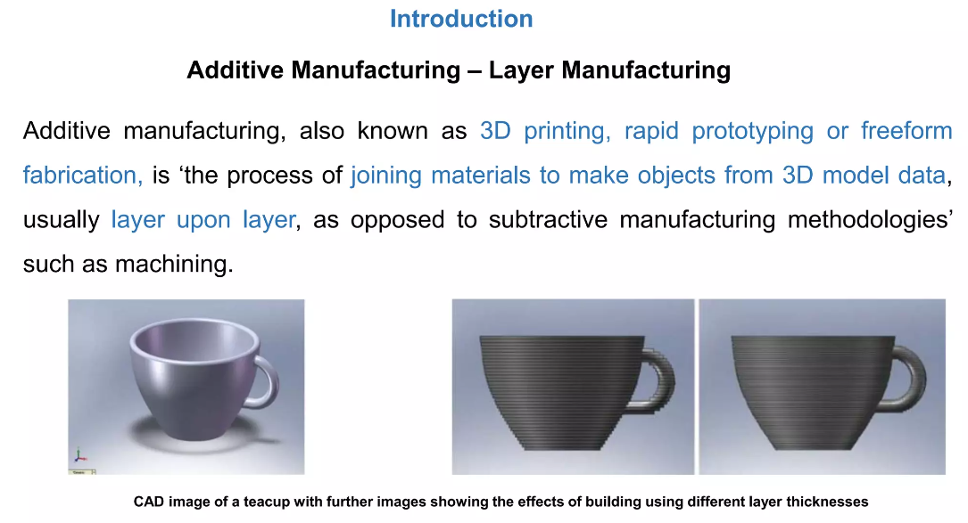

Slide 22
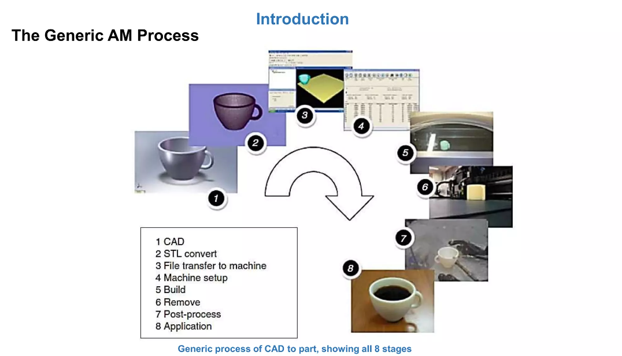

Slide 23
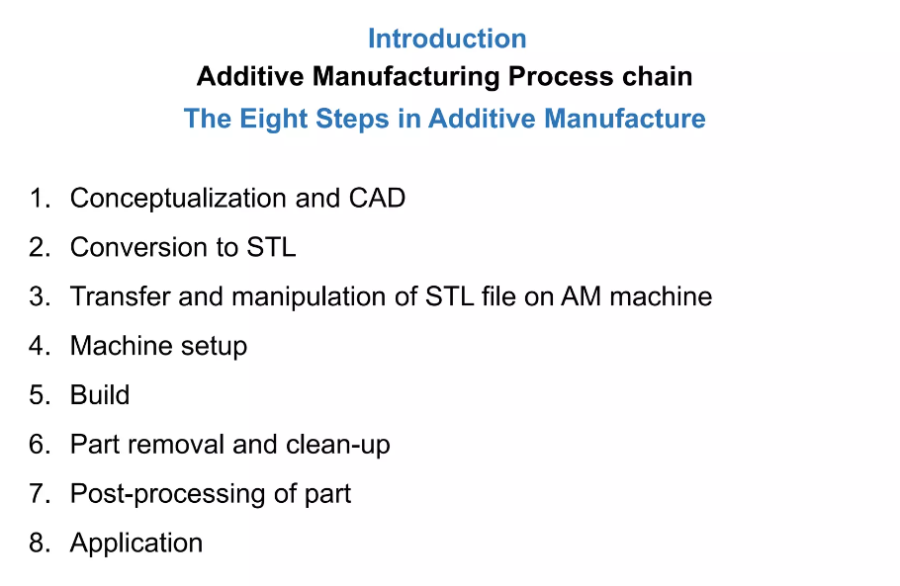

Slide 24
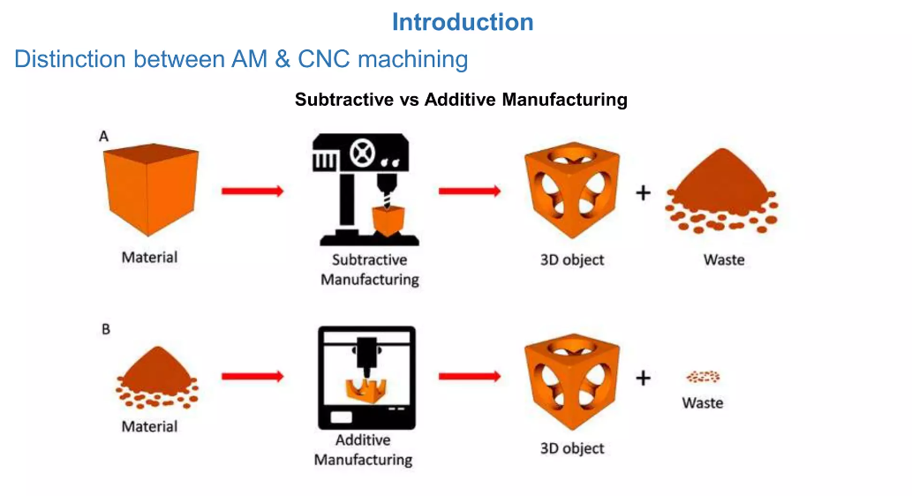

Slide 25
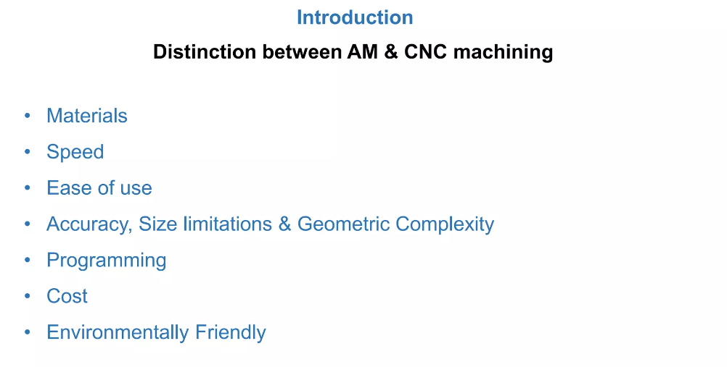

Slide 26
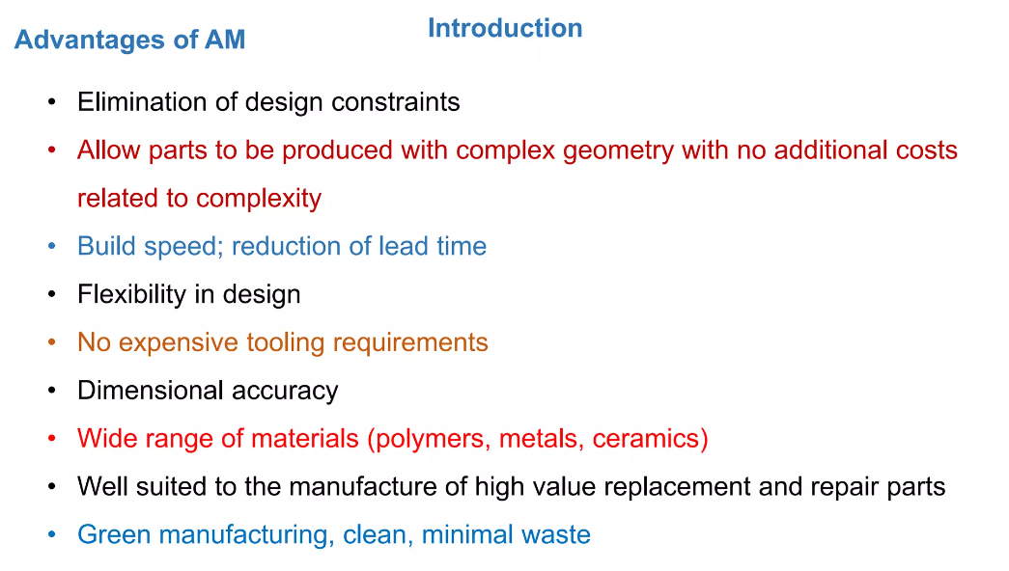

Slide 27
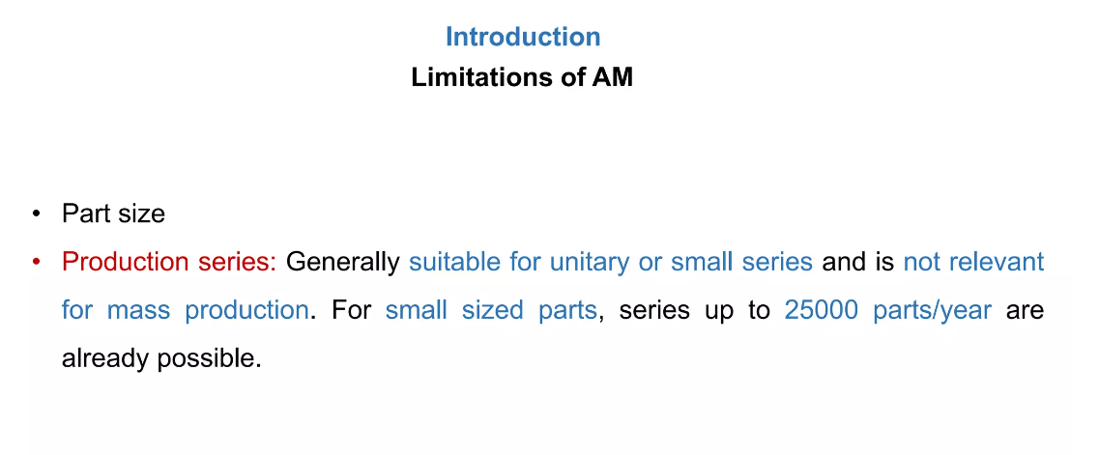

Slide 28
